Slide 1
Sequential Logic
Flip-flops

Slide 2
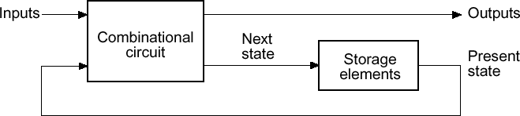
Introduction
Flip flop is a binary cell capable of storing one bit of data.
Flip flop is a sequential circuit (means output= present input + past output).
Flip flop contain memory element to store past output.
Flip flops has two outputs:
  Normal output
  Complement output

Slide 3
Introduction
There are mainly four types of flip flops that are used in electronic circuits:
  The basic flip flop or S-R Flip Flop
  J-K Flip flop
  Delay Flip flop (D Flip flop)
  T (Toggle) Flip flop

Slide 4
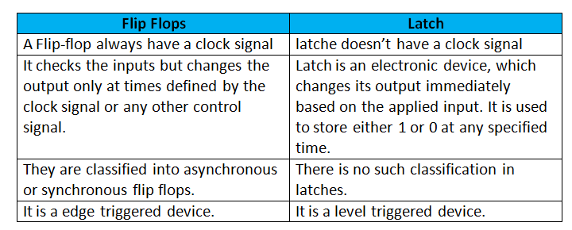
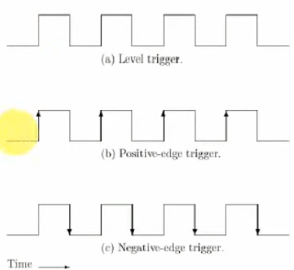
Flip Flops Vs Latch

Slide 5
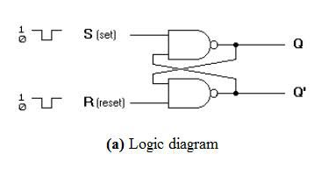
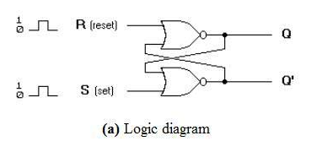
SR Flip Flop
The SET RESET Flip Flop is designed with the help of two NOR gates and also two NAND gates. These flip flops are also called S-R Latch.
S R Flip Flop Using Two NAND Gate
S R Flip Flop Using Two NOR Gate

Slide 6
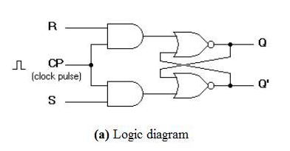
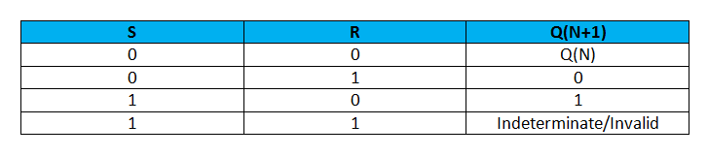
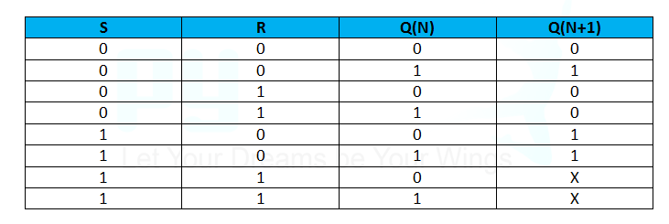
SR Flip Flop
S R Flip Flop Using Two NOR Gate and two AND Gate
Truth Table for SR Flip Flop
Characteristic table for SR Flip Flop
Characteristic equation:- Q(N+1)=S+R`Q(N)

Slide 7
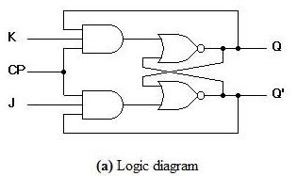
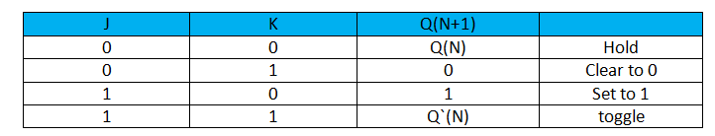
J-K Flip Flop
In SR flip Flop invalid state is present when both inputs are one. to avoid this JK Flip Flop is used. JK Flip Flop is refinement of SR Flip Flop.
Truth table of JK Flip Flop

Slide 8
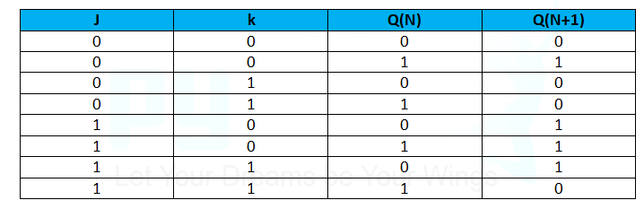
J-K Flip Flop
Characteristic Table
Characteristic Equation: Q(N+1)=JQ`(N)+K`Q(N)

Slide 9
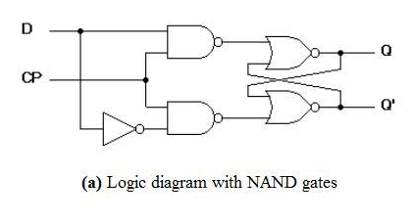
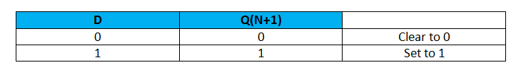
Delay Flip Flop (D Flip Flop)
It is also called transparent latch because in D flip Flop input and output are equal. SR Flip Flop are converted into D Flip Flop by applying inverter between S And R.
Truth table of D Flip Flop

Slide 10
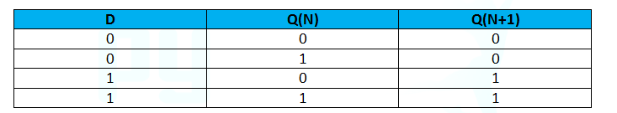
D Flip Flop
Characteristic Table
Characteristic Equation: Q(N+1)=D

Slide 11
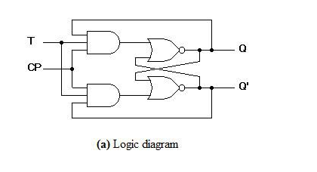
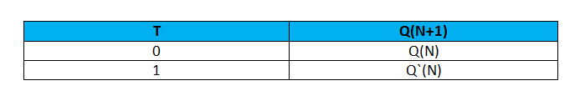
T(Toggle) Flip Flop
Toggle flip flop obtained from JK Flip Flop. in JK flip flop when inputs J and K connected to provide a single input by T.
J= K=T
Truth table of T Flip Flop

Slide 12
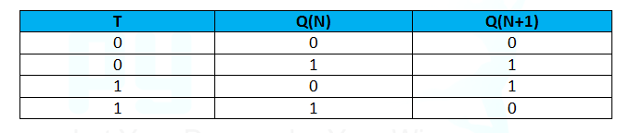
T Flip Flop
Characteristic Table
Characteristic Equation: Q(N+1)= T’Q(N)+Q`(N)T

Slide 13


